Slide 1
Spring Boot
Breakout: Spring JPA vs. Spring JDBC

Slide 2
What's in this video?
A look at Spring JPA and Spring JDBC
What's the difference?
Pros and cons of each
Where is the industry going?
What is Promineo teaching and why?
How does Java JDBC fit in?
Coding Spring JPA vs. Spring JDBC

Slide 3
Spring JPA/Spring JDBC – what's the difference?
JPA: Java Persistence API
JDBC: Java Database Connectivity
Spring JPA:
Built on the Hibernate Object/Relational Mapping (ORM)
Not "true" JPA (Hibernate) but built on top of Hibernate
Spring JDBC:
Templated approach built on Java JDBC
Not Java JDBC but built on top of Java JDBC

Slide 4
Spring JPA: what is it?
Relational databases (RDBMS) define relationships as:
One-to-one
One-to-many
Many-to-many
Java relationships are:
Is A... (inheritance)
Has A... (instance variable)
Uses A... (local variable)

Slide 5
Spring JPA: what is it?
Java knows about objects, inheritance, and embedded objects
Relational databases don't know about any of those things

Slide 6
Spring JPA: what is it?
An ORM (Hibernate) attempts to bridge the gap between Java and relational databases
Hibernate automatically populates tables and Java classes
Hibernate automatically maintains the database relationships
Hibernate will create tables but not populate them

Slide 7
Spring JPA: what is it?
Spring JPA will populate tables with data
Spring JPA provides many common methods in the Data (DAO) layer
Spring JPA creates DAO-layer methods based on programmer-supplied method names (via an interface)

Slide 8
Spring JDBC: what is it?
Spring JDBC provides templates that sit on top of Java JDBC
The programmer mostly doesn't interact with Java JDBC directly
Spring JDBC takes the drudgery out of Java JDBC by writing boilerplate code
Spring JDBC handles transactions correctly by managing exceptions
All Spring JDBC exceptions are unchecked

Slide 9
Spring JPA pros and cons
Pros:
Loads Java objects from table data
Loads tables from Java object data
Can create tables
Maintain table relationships
Programmer can write custom queries using special naming of methods in an interface (Spring JPA provides the implementation)
Isolates/protects programmers from themselves

Slide 10
Spring JPA pros and cons
Cons:
Can create tables
Oftentimes very inefficient
Relationships are modeled with recursive variables
Can't print entities
Can't compare entities
Can't easily transform a Java entity to JSON using the Jackson library
Hard to debug issues
Isolates/protects programmers from themselves

Slide 11
Spring JDBC pros and cons
Pros
JDBC templates mean:
No more exception handling
No more closing resources
Transactions handled with a single annotation
All boilerplate code is already written
The programmer just writes:
The queries
The code to populate Java objects from a ResultSet
With good SQL, JDBC is very efficient

Slide 12
Spring JDBC pros and cons
Cons:
Java objects are not populated automatically
The programmer writes more code than with JPA
The programmer must know SQL in order to write the queries

Slide 13
Where is the industry going?
A quick perusal of Internet documentation shows most newer tutorials/how to documents favor JPA
There is a kind of mythos that programmers must be protected from themselves (this is not without merit)
JPA is a high-level abstraction that bridges object-oriented languages with relational databases

Slide 14
Where is the industry going?
It appears that the industry is moving towards adopting JPA vs. JDBC
Spring Boot shops appear to favor Spring JPA over Spring JDBC

Slide 15
What is Promineo teaching and why?
Based on the perceived industry direction (always risky when analyzed from the before perspective), Promineo is teaching Spring JPA as part of the Spring Boot course

Slide 16
How does Java JDBC fit in?
In the MySQL part of the course, you learned Java JDBC
Java JDBC is a low-level API that is:
Hard to use
Easy to miss closing resources
Extremely verbose, requiring lots of supporting code
But both Spring JPA and Spring JDBC are built on top of Java JDBC
Both are high-level abstractions (simplifications) of the low-level API

Slide 17
What are we coding in this video?
Both projects use the same tables
A bunny breed and description schema

Slide 18
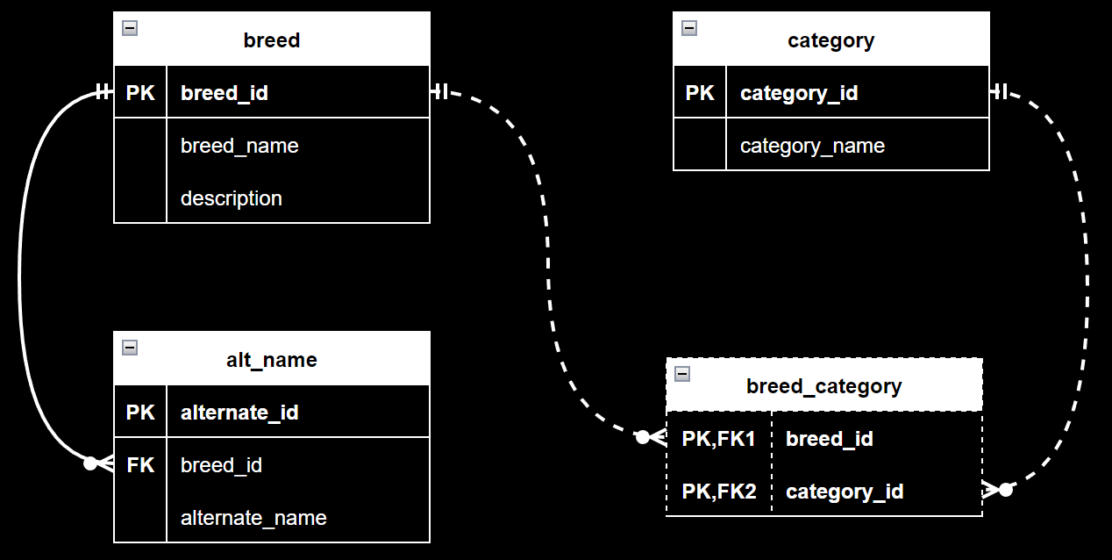

Slide 19
Let's code it!

